Slide 1

Customer Shopping Behavior Analysis
Uncovering insights from 3,900 purchases to guide strategic business decisions through data-driven analysis of spending patterns, customer segments, and product preferences.

Slide 2
Dataset Overview
3,900
18
50
25
Total Purchases
Data Columns
Locations
Product Types
Transactions analyzed across all categories
Comprehensive customer and purchase attributes
Geographic diversity in customer base
Items across multiple categories
Key features include customer demographics (age, gender, location, subscription status), purchase details (item, category, amount, season, size, color), and shopping behavior (discounts, promo codes, previous purchases, frequency, review ratings, shipping type).

Slide 3
Data Preparation & Cleaning
01
01
Data Loading & Exploration
Feature Engineering
Imported dataset using pandas, checked structure with df.info() and summary statistics
Created age_group column by binning customer ages and purchase_frequency_days from purchase data
02
02
Missing Data Handling
Data Consistency Check
Imputed 37 missing Review Rating values using median rating per product category
Verified redundancy between discount_applied and promo_code_used; dropped promo_code_used
03
03
Column Standardization
Database Integration
Renamed columns to snake_case for better readability and documentation
Connected to PostgreSQL and loaded cleaned DataFrame for SQL analysis

Slide 4

Revenue Insights
Male Customers
Female Customers
$157,890 total revenue
$75,191 total revenue
Significantly higher spending contribution
Substantial market segment
High-Value Discount Users
839 customers used discounts but spent above average
Strategic discount effectiveness

Slide 5
Top-Rated Products
77%
77%
76%
Gloves
Sandals
Boots
Highest average rating at 3.86 stars
Strong performance at 3.84 stars
Excellent rating of 3.82 stars
76%
76%
Hat
Skirt
High satisfaction at 3.80 stars
Quality rating of 3.78 stars

Slide 6
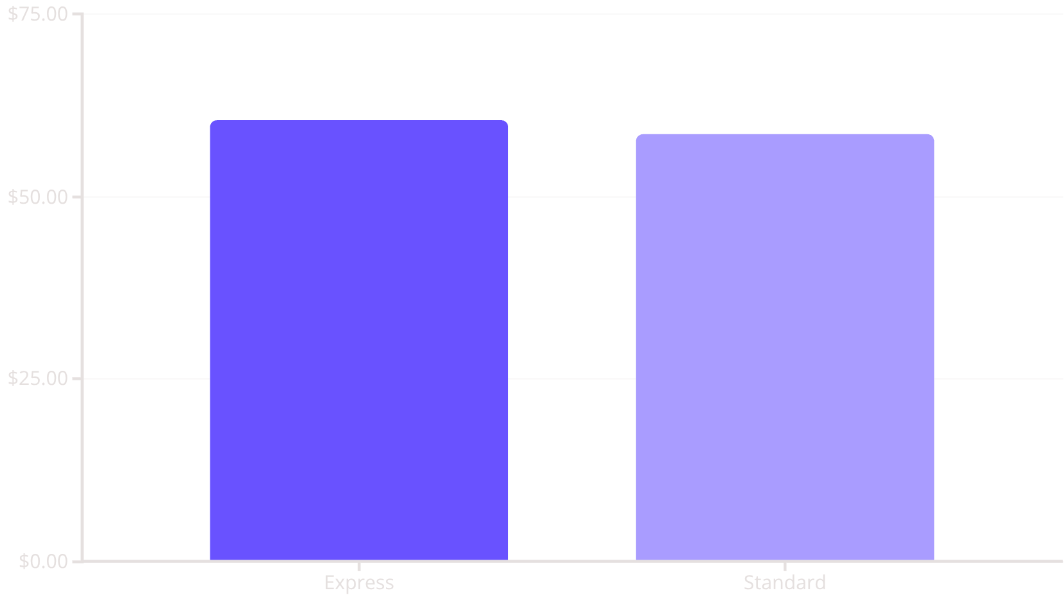
Shipping & Subscription Analysis
Shipping Type Comparison
Subscriber vs. Non-Subscriber
Subscribers (1,053)
Avg spend: $59.49
Total revenue: $62,645
Non-Subscribers (2,847)
Avg spend: $59.87
Total revenue: $170,436
Express shipping customers spend slightly more on average, indicating willingness to pay for faster delivery.
Similar average spending but non-subscribers drive higher total revenue due to larger customer base.

Slide 7



Customer Segmentation
New
1
83 customers
Returning
2
701 customers
Loyal
3
3,116 customers
The majority of customers (80%) fall into the Loyal segment, demonstrating strong customer retention. However, 958 of the 3,116 repeat buyers (>5 purchases) have subscriptions, indicating opportunity for subscription growth.

Slide 8
Product Performance by Category
Accessories
Clothing
Footwear
Outerwear
Top sellers: Jewelry (171), Sunglasses (161), Belt (161)
Top sellers: Blouse (171), Pants (171), Shirt (169)
Top sellers: Sandals (160), Shoes (150), Sneakers (145)
Top sellers: Jacket (163), Coat (161)

Slide 9
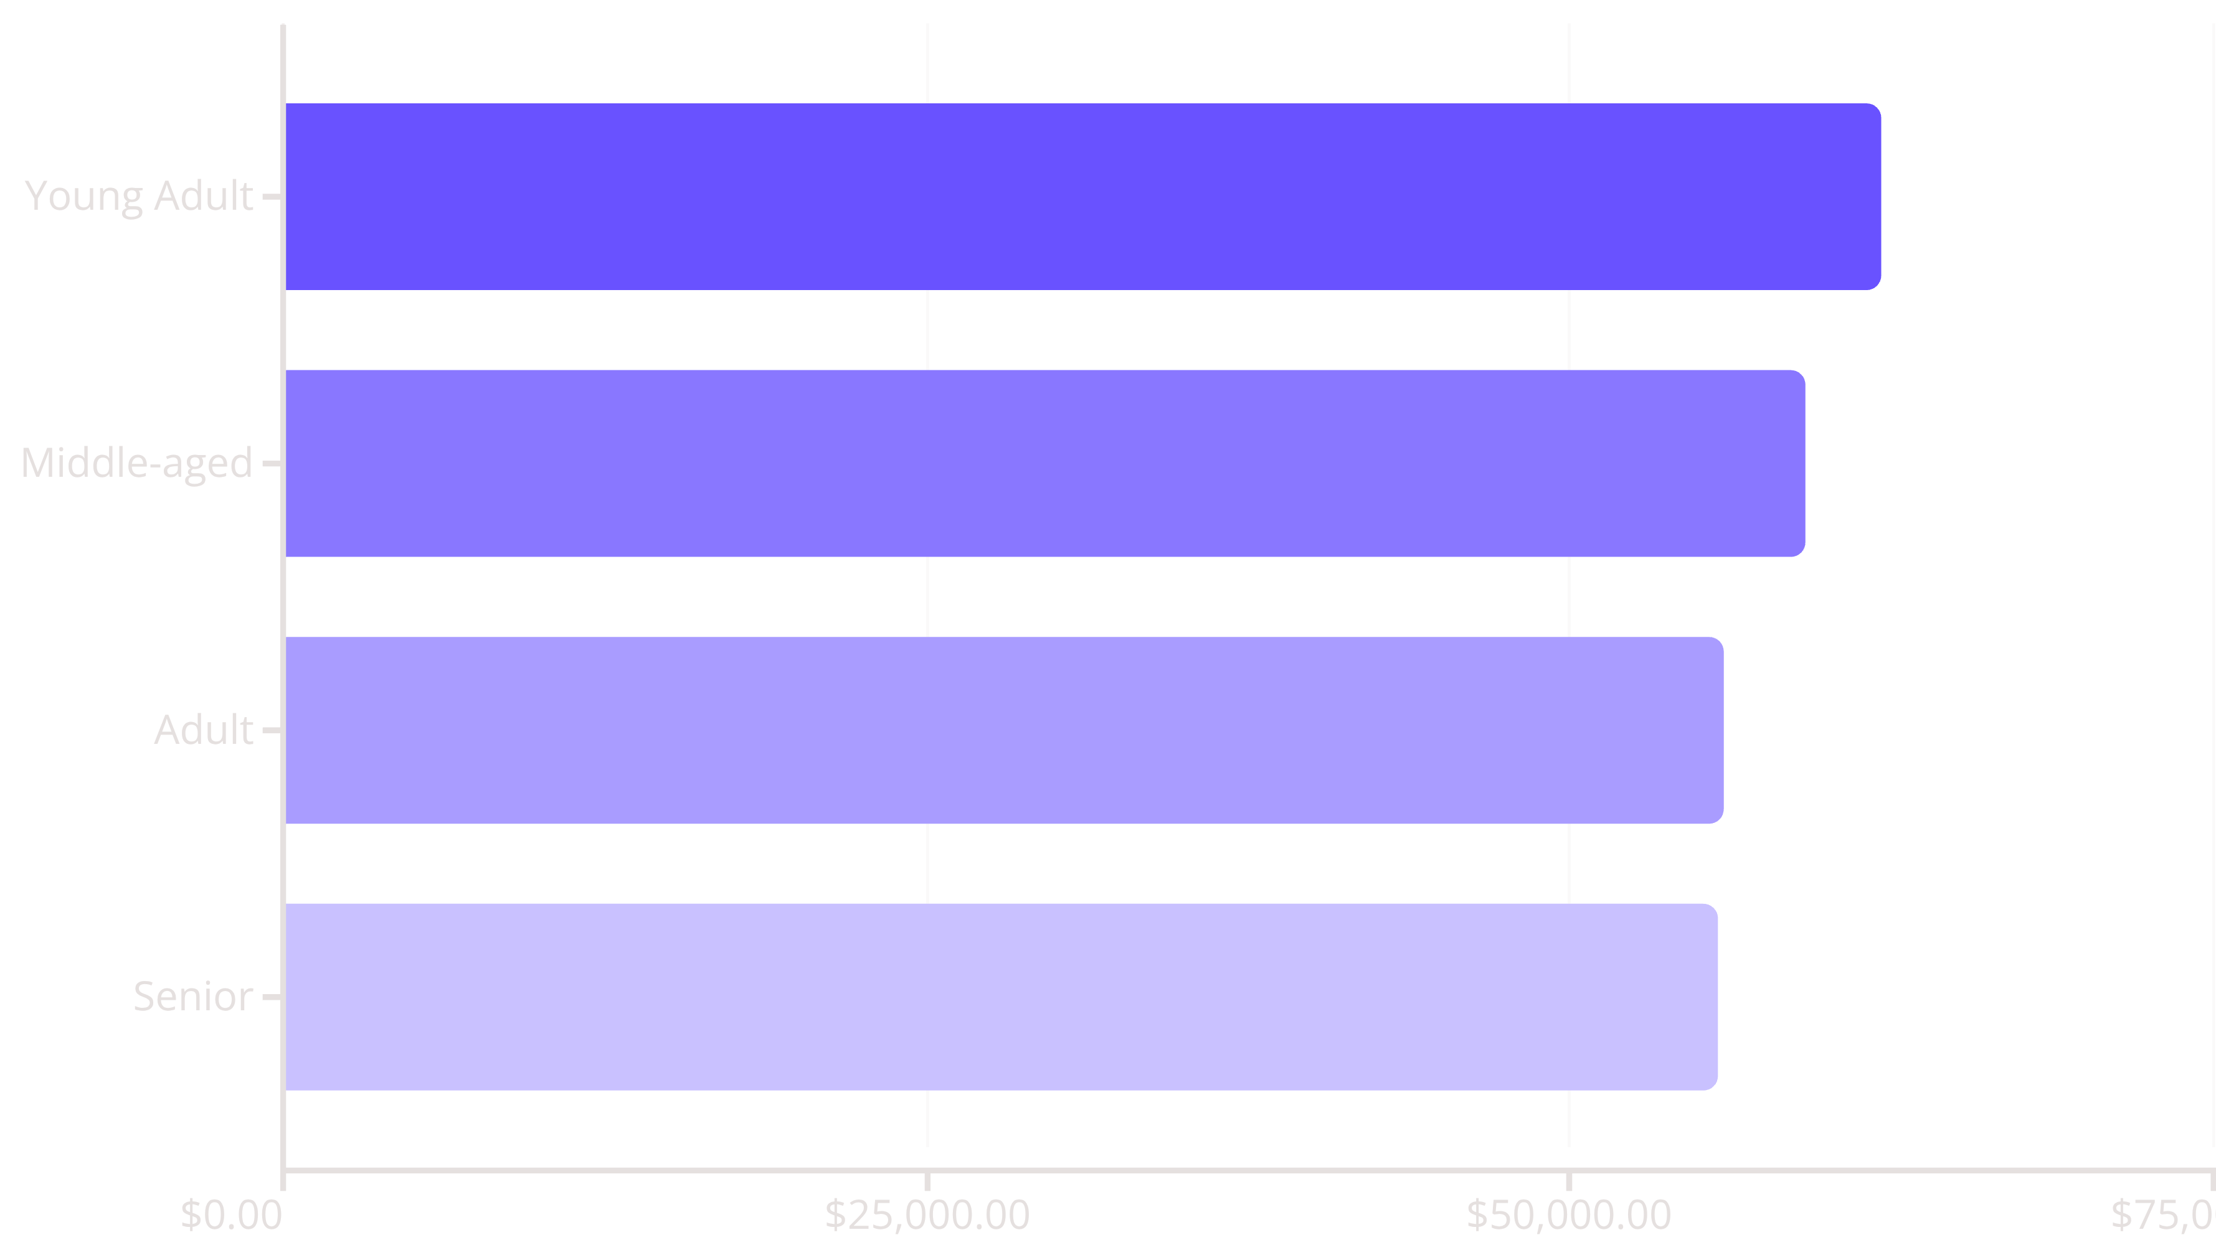
Revenue by Age Group
Young adults generate the highest revenue at $62,143, followed closely by middle-aged customers. Revenue distribution is relatively balanced across age groups, suggesting broad market appeal.

Slide 10





Strategic Recommendations
Boost Subscriptions
Customer Loyalty Programs
Review Discount Policy
Promote exclusive benefits for subscribers to convert the 2,518 repeat buyers without subscriptions
Reward repeat buyers to accelerate movement into the Loyal segment
Balance sales boosts with margin control—839 high-spenders used discounts effectively
Product Positioning
Targeted Marketing
Highlight top-rated products (Gloves, Sandals, Boots) and best-sellers in marketing campaigns
Focus efforts on high-revenue young adults and express-shipping users willing to pay premium

